Slide 1
📱 Mobile Sales Dashboard Analysis
Interactive Business Intelligence Dashboard using Power BI
Analyzing Revenue, Sales Trends, Customer Transactions, Product Performance, MTD & SPLY Metrics
By Abhishek Savita

Slide 2
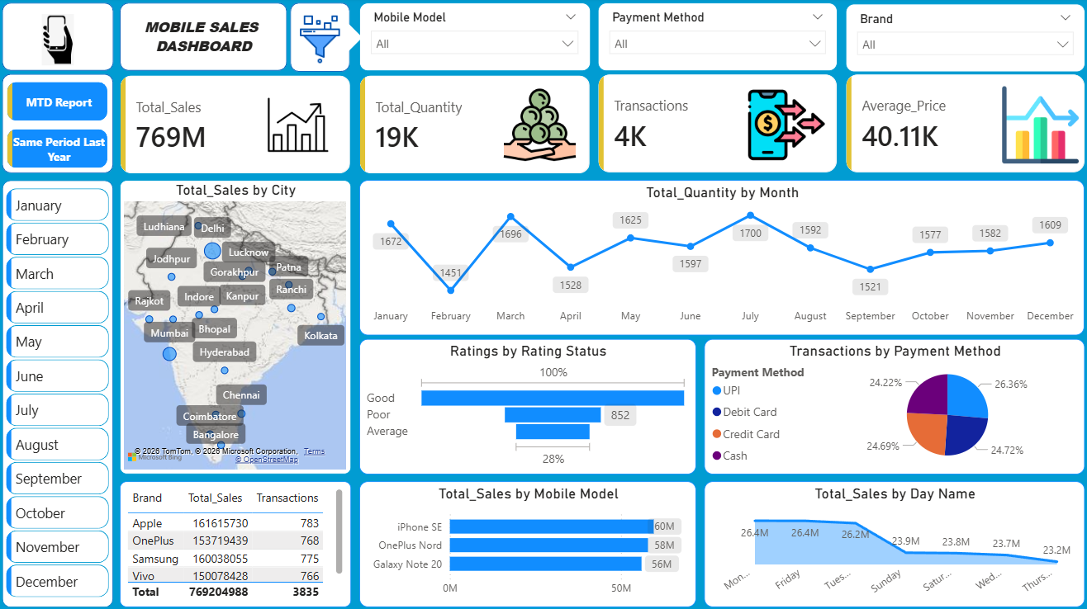
📌 Project Overview
Project Description: This project analyzes mobile sales data using Power BI to uncover sales trends, customer behavior, product performance, and revenue insights. Interactive dashboards and KPI monitoring support data-driven business decisions.
🎯 Objectives
Analyze overall sales performance and key KPIs.
Identify top-performing brands and mobile models.
Understand city-wise and payment-wise sales patterns.
Track Month-to-Date (MTD) performance.
Compare sales with Same Period Last Year (SPLY).
🛠 Tools & Technologies Used
• Power BI • Microsoft Excel • Power Query • DAX (Data Analysis Expressions) • Data Modeling • Data Visualization
📊 Dashboard Features
✅ Interactive Filters & Slicers ✅ KPI Monitoring ✅ Brand & Product Analysis ✅ City-wise Sales Analysis ✅ Payment Method Analysis ✅ MTD & SPLY Reporting
📈 Expected Outcome
Deliver actionable insights into sales performance, customer behavior, and market trends to enable data-driven business decisions and improve business growth.

Slide 3
📂 Dataset Overview :
Dataset Description The dataset contains mobile phone sales transactions across different cities, brands, mobile models, payment methods, and time periods.
Dataset Information
Total Transactions: 4,000+ Total Revenue: ₹769M Total Units Sold: 19K Average Selling Price: ₹40.11K Analysis Period: 2021–2024
Key Attributes
Transaction ID
Date
City
Brand
Mobile Model
Quantity Sold
Unit Price
Total Sales
Payment Method
Customer Rating
Business Questions Addressed
Which brands generate the highest revenue?
Which cities contribute most to sales?
Which payment methods are preferred?
How does sales performance change over time?
How does current performance compare with the previous year?
• Which mobile models contribute most to revenue?
Data Preparation Steps
Data Cleaning
Missing Value Handling
Data Type Transformation
Data Modeling
DAX Measure Creation
Interactive Dashboard Development

Slide 4


📊 KPI Summary Dashboard
🎯 Key Performance Indicators (KPIs)
The dashboard provides a high-level overview of mobile sales performance through key business metrics. These KPIs help stakeholders monitor revenue, sales volume, customer transactions, and pricing trends.
💰 Total Sales
₹769 Million
Represents the total revenue generated from mobile phone sales.
Indicates strong overall business performance.
Serves as the primary metric for measuring business growth.
📦 Total Quantity Sold
19K Units
Total number of mobile phones sold during the analysis period.
Reflects customer demand and product movement.
Helps evaluate inventory and supply chain requirements.
🧾 Total Transactions
4K Transactions
Total customer purchase transactions recorded.
Provides insights into customer purchasing activity.
Useful for analyzing sales frequency and customer engagement.
💵 Average Selling Price
₹40.11K
Average revenue generated per mobile phone sold.
Indicates strong demand for mid-range and premium smartphones.
Helps assess pricing strategy and product positioning.
📈 KPI Insights
✅ Generated ₹769M in total revenue. ✅ Sold over 19K mobile units across 4K transactions. ✅ Strong demand for mid-range and premium smartphones. ✅ Maintained an average selling price of ₹40.11K per device. ✅ Indicates stable sales performance and healthy business growth.

Slide 5
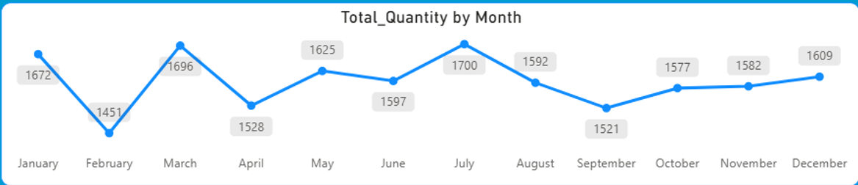
📈 Monthly Sales Trend Analysis
🎯 Monthly Sales Performance
This analysis examines monthly sales quantity trends to identify peak sales
periods, low-performing months, and seasonal demand patterns throughout
the year.
🔍 Key Insights
🏆 Highest Performing Month
July (1,700 Units)
Recorded the highest quantity sold.
Indicates strong customer demand and market activity.
May be influenced by seasonal offers or product launches.
📈 Strong Sales Months
Top Performing Months: • July (1,700) • March (1,696) • January (1,672)
📉 Lowest Performing Month
February (1,451 Units)
Recorded the lowest sales volume.
Represents a decline compared to January and March.
May indicate reduced customer demand during this period.
🔄 Sales Stability
Sales remained stable between 1,451 and 1,700 units, indicating
consistent customer demand throughout the year.
💡 Business Recommendations :
✅ Increase inventory before March and July.
✅ Run promotions during February and September.
✅ Analyze successful strategies from peak months.
✅ Maintain stock levels to meet consistent demand.
📌 Conclusion
Sales remained consistent throughout the year, with July emerging as the strongest month and February as the weakest. The stable sales pattern indicates predictable customer demand and effective market performance.

Slide 6
🏙️City-wise & Brand-wise Sales Analysis
📍 City-wise Sales Analysis
The city-wise sales analysis helps identify geographic regions contributing the highest revenue and sales volume.
🔍 Key Insights
🏆 Top Revenue-Contributing Cities
• Delhi • Mumbai • Bangalore • Hyderabad • Lucknow
📈 Metropolitan cities emerged as the primary revenue drivers, reflecting stronger customer demand and purchasing power.
📊 Sales distribution is concentrated in urban markets with higher smartphone demand.
🌍 Strong market presence is observed across multiple regions of India, reducing dependency on a single location.
🏷️ Brand-wise Sales Analysis
Revenue by Brand
Brand | Total Sales
Apple | ₹161.62M
Samsung | ₹160.04M
OnePlus | ₹153.72M
Vivo | ₹150.08M
🔍 Key Insights
🥇 Apple generated the highest revenue among all brands.
📱 Samsung closely followed Apple, indicating strong competition in the smartphone market.
⚖️Revenue is distributed relatively evenly among leading brands, indicating healthy market competition.
📈 Premium and mid-range smartphone brands dominate overall sales performance.
💡 Business Recommendations
✅ Maintain sufficient inventory for Apple, Samsung, OnePlus, and Vivo devices.
✅ Increase marketing investments in high-performing cities to maximize revenue.
✅ Explore growth opportunities in Tier-2 and Tier-3 cities.
✅ Introduce region-specific promotional campaigns based on city-wise demand patterns.
📌 Conclusion :
Metropolitan cities contribute significantly to overall sales performance, while Apple, Samsung, OnePlus, and Vivo remain the leading revenue-generating brands. The balanced brand contribution and strong regional presence indicate a stable and diversified mobile sales market.

Slide 7
📱Mobile Model & Payment Method Analysis
📱 Mobile Model Analysis
The mobile model analysis identifies the best-performing smartphone models based on total sales revenue and helps understand customer product preferences.
🏆 Top Performing Mobile Models
🔍 Key Insights
🥇 iPhone SE generated the highest sales revenue among all mobile models.
📱 OnePlus Nord and Galaxy Note 20 also demonstrated strong market performance.
💰 Customers showed a preference for premium and upper mid-range smartphones.
📈A small group of flagship models contributes significantly to overall sales revenue.
💳 Payment Method Analysis
The payment method analysis helps understand customer transaction preferences and purchasing behavior.
Transaction Distribution by Payment Method
Payment Method | Share
UPI | 26.36%
Debit Card | 24.72%
Credit Card | 24.69%
Cash | 24.22%
Mobile Model | Total Sales
iPhone SE | ₹60M
OnePlus Nord | ₹58M
Galaxy Note 20 | ₹56M
🔍 Key Insights
🥇 UPI emerged as the most preferred payment method.
📲 Digital payment methods account for nearly 75% of total transactions.
⚖️ Transaction distribution is relatively balanced across all payment methods.
💡 The growing adoption of digital payments highlights a shift toward faster and more convenient transaction methods.
💡 Business Recommendations
✅ Maintain adequate inventory levels for top-performing mobile models.
✅ Focus promotional campaigns on best-selling smartphones.
✅ Partner with UPI providers to offer cashback and discount schemes.
✅ Encourage digital payments through exclusive offers and loyalty programs.
📌 Conclusion
Premium smartphone models contribute significantly to overall revenue, while UPI remains the most preferred payment method, highlighting strong demand for high-value products and digital payment solutions.

Slide 8
⭐ Customer Rating & Weekday Sales Analysis
Customer Rating Analysis
Customer ratings provide insights into customer satisfaction levels and overall product experience.
📊 Rating Distribution
📅 Weekday Sales Analysis
The weekday sales analysis helps identify the days generating the highest and lowest revenue.
💰 Sales by Day
Rating Status | Observation
Good | Highest Share
Average | Moderate Share
Poor | Lowest Share
Day | Sales
Monday | ₹26.4M
Friday | ₹26.4M
Tuesday | ₹26.2M
Sunday | ₹23.9M
Saturday | ₹23.8M
Wednesday | ₹23.7M
Thursday | ₹23.2M
🔍 Key Insights
😊 Most customers provided positive ratings, indicating overall satisfaction with products and services.
📈 Good ratings significantly outnumber average and poor ratings.
🤝 Positive customer experiences contribute to customer loyalty and repeat purchases.
💡 Low poor-rating counts suggest effective product quality and customer service.
🔍 Key Insights
🏆 Monday and Friday recorded the highest sales revenue.
📉 Thursday generated the lowest sales revenue.
📊 Sales remained relatively stable throughout the week with only minor fluctuations.
🛍️ Customers tend to make more purchases at the beginning and end of the workweek.
💡 Business Recommendations
✅ Introduce targeted promotions and discounts on low-performing weekdays to boost sales.
✅ Schedule new product launches during high-performing days.
✅ Use weekday sales trends for inventory and staffing planning.
✅ Maintain high customer satisfaction through quality products and service.

Slide 9
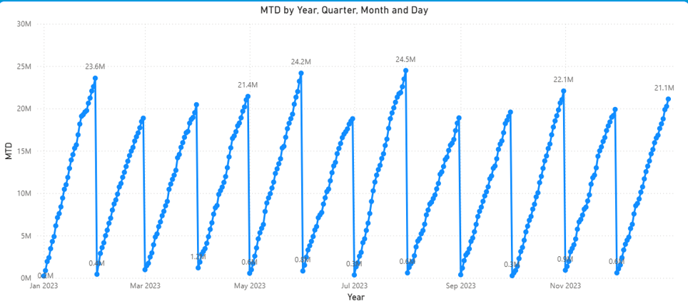
📈 Month-to-Date (MTD) Sales Analysis
📊 MTD Performance Analysis
The Month-to-Date (MTD) dashboard tracks cumulative sales growth throughout each month, helping monitor sales progress and identify performance trends over time.
🔍 Key Insights
🚀 Consistent Monthly Growth
Sales show a steady upward trend throughout each month.
Revenue accumulates progressively from the beginning to the end of the month.
🏆 Highest MTD Performance
July recorded one of the highest MTD values at approximately ₹24.5M.
June and January also demonstrated strong MTD growth.
📈 Strong Sales Momentum
Most months crossed the ₹20M sales mark before month-end.
Indicates stable customer demand and effective sales performance.
⚡ Predictable Growth Pattern
Similar growth patterns are observed across multiple months.
Suggests a stable and consistent sales cycle.
📉 Monthly MTD Highlights
Month | Peak MTD Sales
January | ₹23.6M
May | ₹21.4M
June | ₹24.2M
July | ₹24.5M
November | ₹22.1M
December | ₹21.1M
💡 Business Recommendations
✅ Monitor MTD performance regularly to identify sales trends early.
✅ Replicate strategies used during high-performing months such as June and July.
✅ Introduce targeted promotions during slower months to accelerate sales growth.
✅ Use MTD tracking for inventory planning and sales forecasting.
📌 Conclusion
The MTD analysis demonstrates consistent sales growth throughout the year, with several months exceeding ₹20M in cumulative sales. These trends highlight strong market demand and support effective forecasting, inventory planning, and business decision-making.

Slide 10
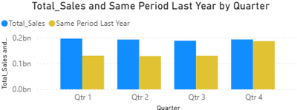
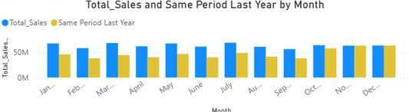
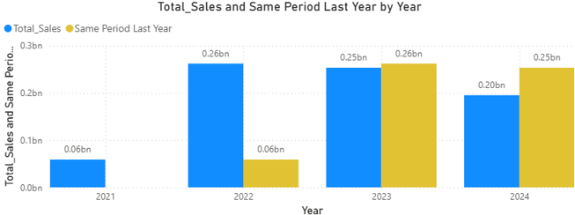
📊 Same Period Last Year (SPLY) Analysis
📈 SPLY Performance Analysis
The Same Period Last Year (SPLY) analysis compares current sales performance with the corresponding period in the previous year to evaluate business growth trends and identify areas for improvement.
🔍 Key Insights
📅 Year-wise Comparison
🏆 2022 recorded significant growth compared to 2021, reflecting strong business expansion.
📊 2023 maintained a stable sales performance, with sales levels remaining comparable to the previous year.
📉 2024 sales declined compared to SPLY, indicating potential challenges in maintaining previous growth levels.
📆 Quarter-wise Comparison
🚀 Q4 delivered the strongest sales performance, contributing the highest revenue among all quarters.
📈 Sales remained relatively consistent across all quarters, indicating stable business operations.
⚖️ Quarterly revenue distribution shows balanced performance throughout the year.
📊 Month-wise Comparison
📈 Current sales outperformed SPLY in several months, demonstrating positive growth.
🏆 January, March, May, and July emerged as strong-performing months.
📉 Some months showed lower performance than the previous year, highlighting opportunities for improvement.
💡 Business Recommendations
✅ Identify root causes behind underperforming months and implement targeted improvement strategies.
✅ Replicate strategies from high-growth periods.
✅ Strengthen promotional activities during weaker quarters.
✅ Use SPLY trends for forecasting and planning.

Slide 11
🎯 Key Findings & Business Recommendations
🔍 Key Findings
💰 Generated ₹769M in total sales revenue.
📦 Sold over 19K mobile units through approximately 4K transactions.
📈 July emerged as the highest-performing month, while February recorded the lowest sales volume.
🏙️ Delhi, Mumbai, Bangalore, Hyderabad, and Lucknow were the top revenue-contributing cities.
🏷️ Apple generated the highest brand revenue, followed closely by Samsung.
📱 iPhone SE, OnePlus Nord, and Galaxy Note 20 were the top-performing mobile models.
💳 UPI emerged as the most preferred payment method, highlighting the growing adoption of digital payments.
⭐ Customer ratings indicated a high level of overall customer satisfaction.
💡 Business Recommendations
📦 Maintain adequate inventory levels for top-selling brands and mobile models.
🏙️ Increase marketing efforts in high-performing metropolitan cities.
💳 Expand digital payment incentives such as cashback and promotional offers.
📅 Launch targeted campaigns during low-performing months and weekdays to boost sales.
📊 Leverage MTD and SPLY insights for sales forecasting, inventory planning, and strategic decision-making.
📈 Replicate successful strategies from peak-performing periods to sustain business growth.
📌 Final Conclusion
The Mobile Sales Analysis Dashboard successfully transformed raw sales data into actionable insights, enabling better decision-making related to sales performance, customer preferences, product demand, inventory planning, and business growth. Through interactive visualizations and KPI monitoring, the dashboard provides a comprehensive view of business performance and supports data-driven strategies.

Slide 12
🙏 THANK YOU
Questions and Answers
Presented By :
Abhishek Savita
B.Tech – Computer Science & Engineering
📧asavita3012@gmail.com
💼 LinkedIn: linkedin.com/in/abhishek-savita-b41961276
🐙 GitHub: github.com/Abhishek-Savita-3012

